Slide 1

Terraform

Slide 2

Session 1 :
Why Terraform? What is Importance of it ?
Terminology and Concepts.
First Simple Terraform file for ec2-creation.

Slide 3

Why Terraform?
So, you can create an infrastructure by writing code in shell scripting, python, or any Json and yaml- template.
Tools available in market.
AWS - CFT
Azure - ARM - Azure Resource Manager
OpenStack -Heat Templates
If the templates are already present but then question comes why terraform?
let's say your organization is using AWS and one of the project comes in for Azure so as a DevOps engineer i might need to learn all tools or any person who is trying to automate the infrastructure, they cannot learn all these tools
Terraform saw this opportunity and said we will come with universal option, and it came up with an approach called as providers.
So, terraform says learn HCL language and you don't need to worry about each templates or language for different cloud.

Slide 4
Terminology and concepts
1. **Provider**: A provider is a plugin for Terraform that defines and manages resources for a specific cloud or infrastructure platform. Examples of providers include AWS, Azure, Google Cloud, and many others. You configure providers in your Terraform code to interact with the desired infrastructure platform.
2. **Resource**: A resource is a specific infrastructure component that you want to create and manage using Terraform. Resources can include virtual machines, databases, storage buckets, network components, and more.
3. **Module**: A module is a reusable and encapsulated unit of Terraform code. Modules allow you to package infrastructure configurations, making it easier to maintain, share, and reuse them across different parts of your infrastructure. Modules can be your own creations or come from the Terraform Registry, which hosts community-contributed modules.
4. **Variable**: Variables in Terraform are placeholders for values that can be passed into your configurations. They make your code more flexible and reusable by allowing you to define values outside of your code and pass them in when you apply the Terraform configuration.

Slide 5
5. **Output**: Outputs are values generated by Terraform after the infrastructure has been created or updated. Outputs are typically used to display information or provide values to other parts of your infrastructure stack.
6. **State File**: Terraform maintains a state file (often named `terraform.tfstate`) that keeps track of the current state of your infrastructure. This file is crucial for Terraform to understand what resources have been created and what changes need to be made during updates.
7. **Workspace**: Workspaces in Terraform are a way to manage multiple environments (e.g., development, staging, production) with separate configurations and state files. Workspaces help keep infrastructure configurations isolated and organized.
8. **Remote Backend**: A remote backend is a storage location for your Terraform state files that is not stored locally. Popular choices for remote backends include Amazon S3, Azure Blob Storage, or HashiCorp Terraform Cloud.

Slide 6
Terraform Lifecycle
1. **init** : ‘terraform init’ command initializes a working directory containing Terraform configuration files. This is the first command that should be run after writing a new Terraform configuration.
2. **Plan**: A ‘terraform plan’ is a preview of changes that Terraform will make to your infrastructure. When you run `terraform plan`, Terraform analyses your configuration and current state, then generates a plan detailing what actions it will take during the `apply` step.
3. **Apply**: The `terraform apply` command is used to execute the changes specified in the plan. It creates, updates, or destroys resources based on the Terraform configuration.
4. **Destroy**: The `terraform destroy` command is used to execute the changes specified in the plan. It creates, updates, or destroys resources based on the Terraform configuration.

Slide 7

Terraform Registry
aws_instance | Resources | hashicorp/aws | Terraform | Terraform Registry
AMICatalog – You can go to AMI catlog to find different ami ids

Slide 8
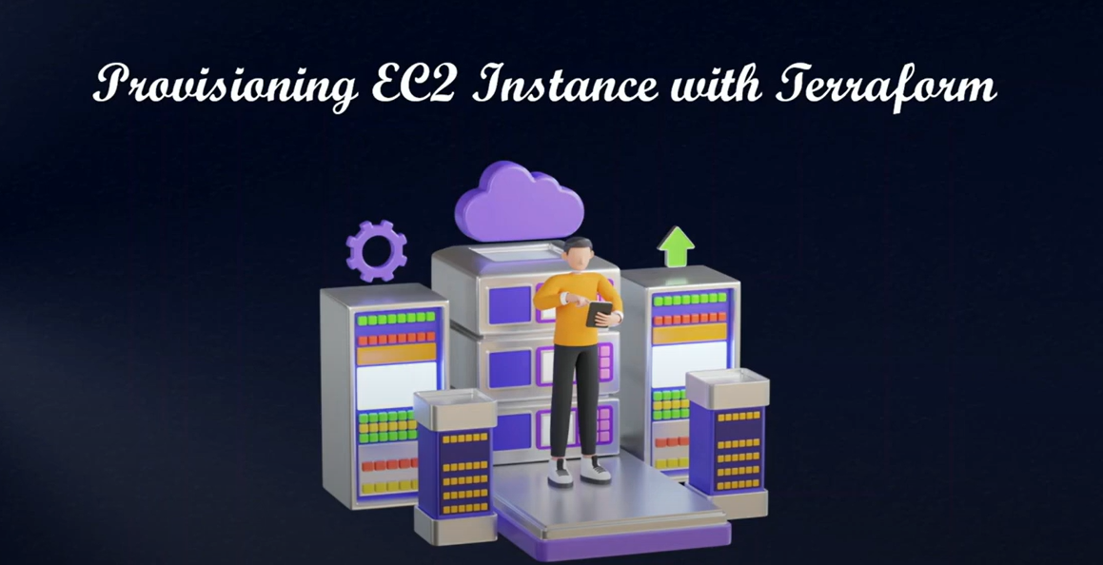

Slide 9
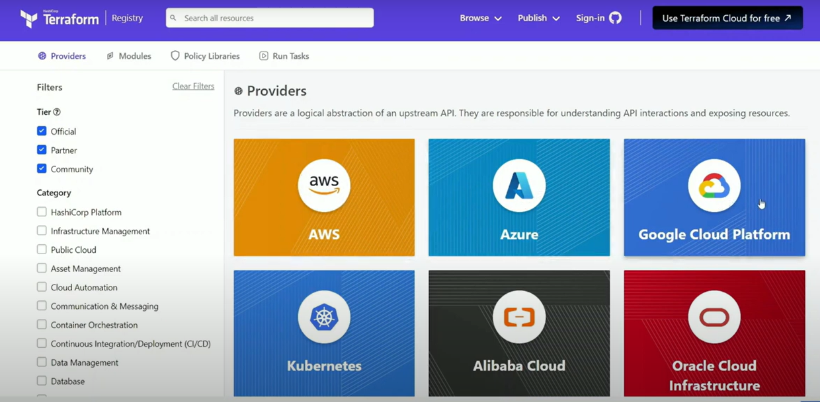
Terraform providers : Terraform Registry

Slide 10
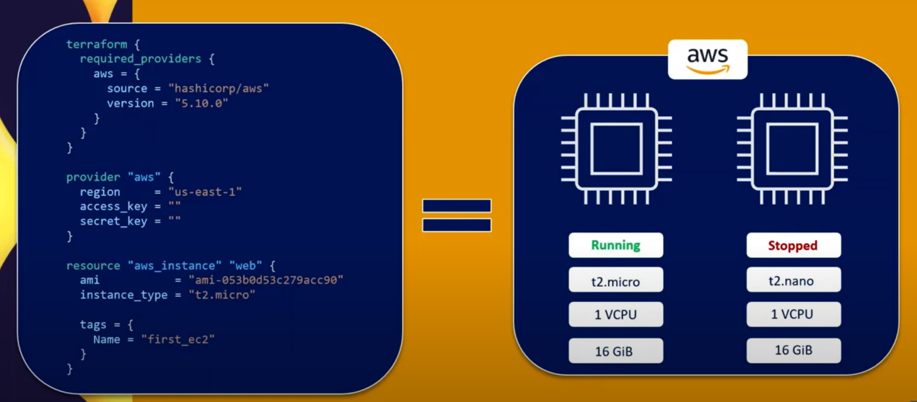
Desired State & Current State: Terraform aims to ensure that desired state(terraform code) and current state(infra running on AWS) will be same.

Slide 11
Challenges.
1) If someone manually updates the infra from AWS console then terraform will try to make the changes present in desired file – terraform code .
Point to note – if default values are changed from AWS console terraform desired state will still match the current state.
Example - security group first was selected as default later changed manually but as per the terraform code it default hence whatever set manually will be considered as default.

Slide 12
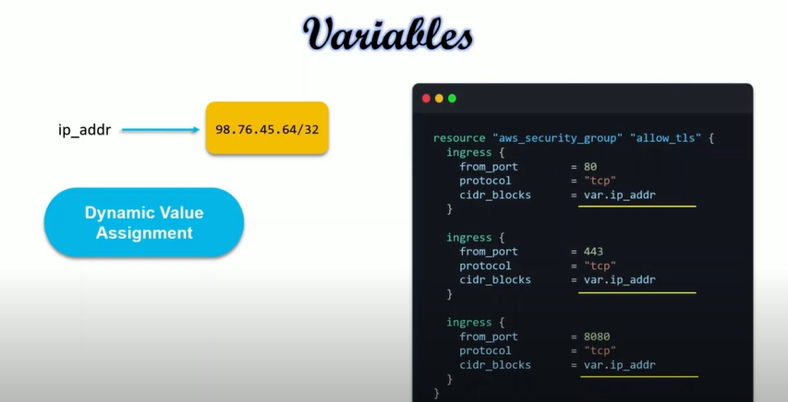
Terraform Variables

Slide 13
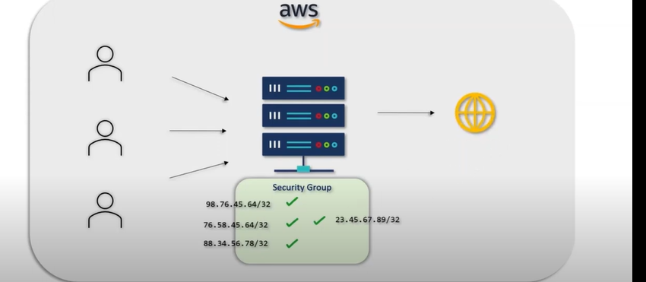
Resource creation – Security group –we will use variable concept here.
Inbound and Outbound Rules for your server

Slide 14
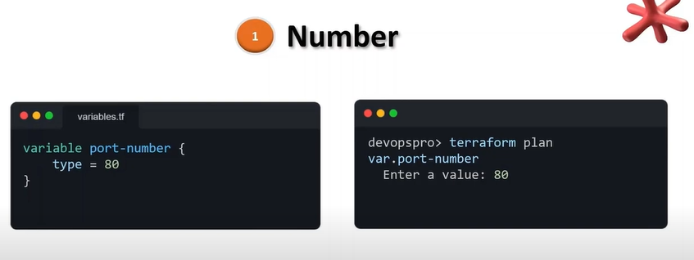
Data Types

Slide 15
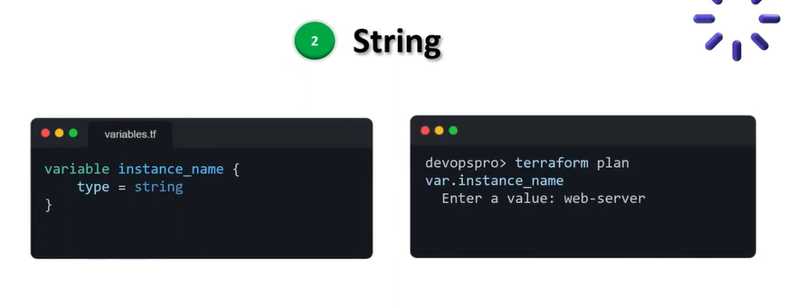

Slide 16
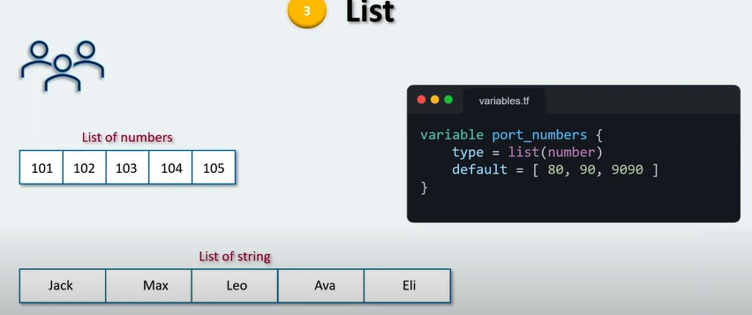

Slide 17
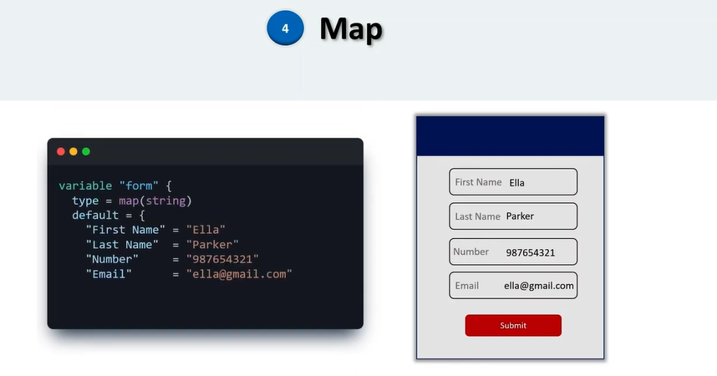

Slide 18
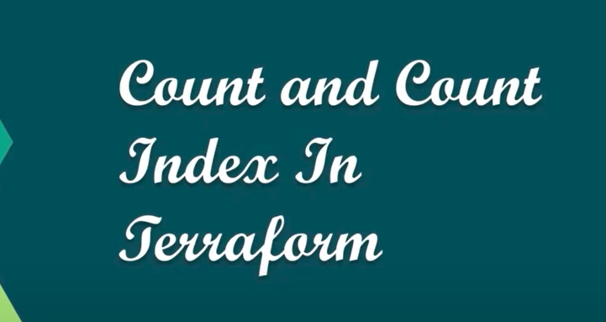

Slide 19
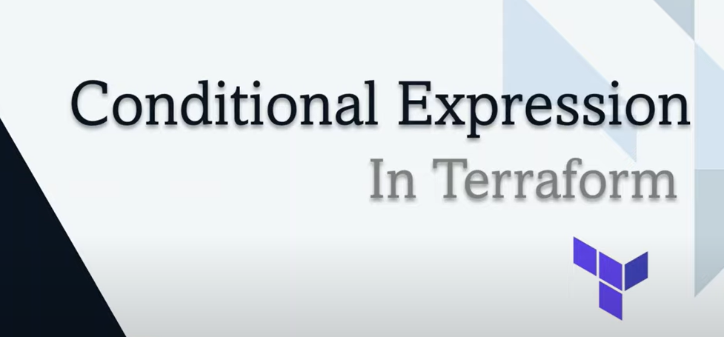

Slide 20
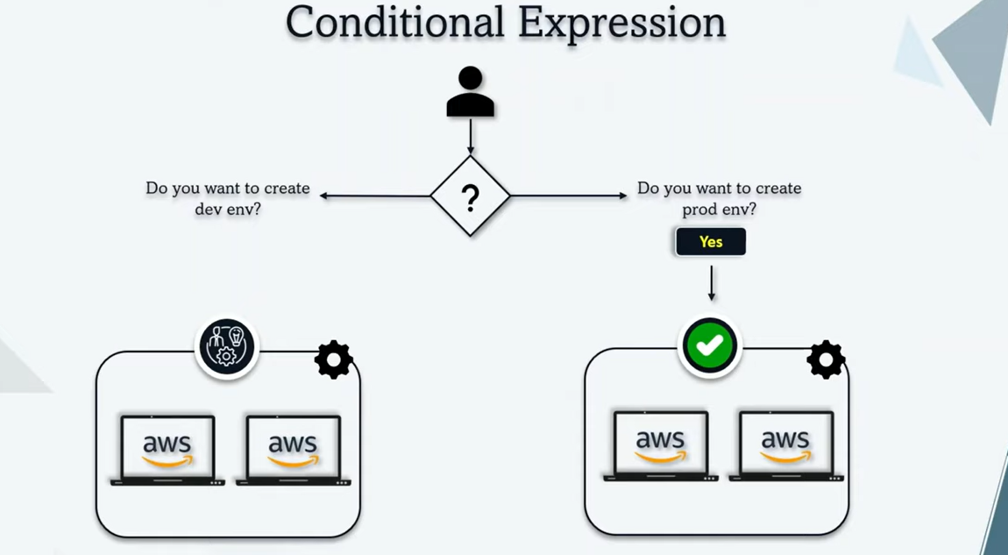

Slide 21
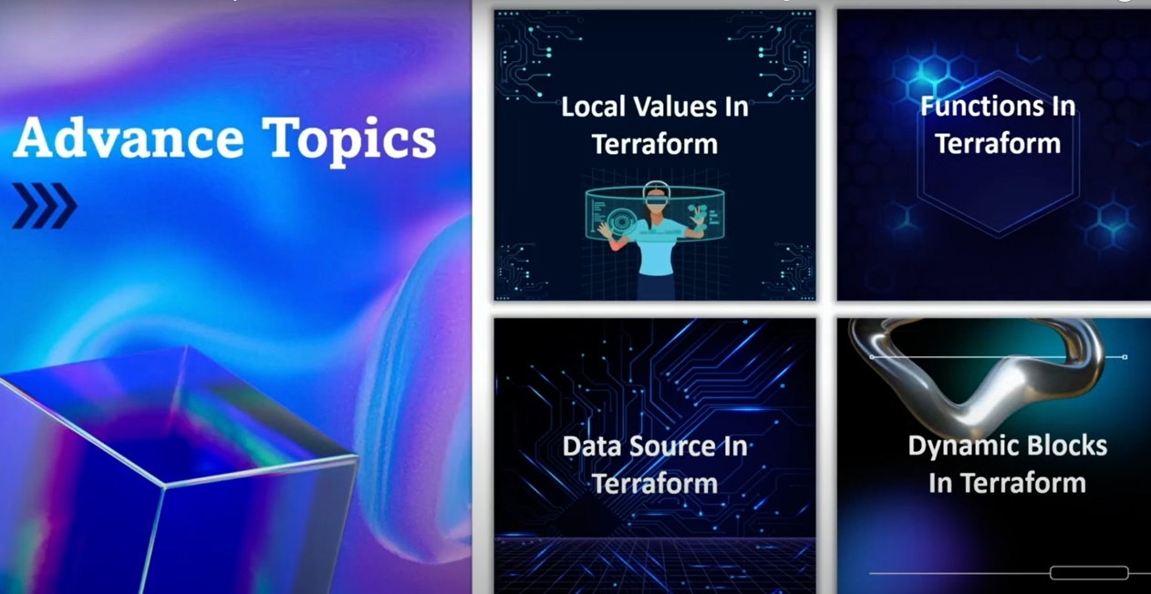

Slide 22
